Slide 1

GTC Ignite Security & NextGen Present
OWASP Top Ten Workshops
A9 Known Vulnerabilities
Alec-Angus Macdonald
go/alec
Notes:
Using Components With Known Vulnerabilities
.

Slide 2

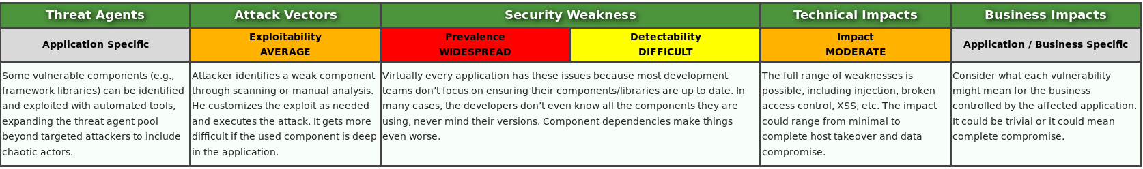
Notes:
App specific: fingerprinting
.
Attack vector: Most likely needs to be specifically crafted
.
Hard to detect and everywhere
.
Impact: Depends on what the vulnerability actually is
.
Business Impact: Full devistation (potentially)

Slide 3

Notes:
Case Study : Shellshock/ Bashbug/ Bashdoor
.
Disclosed 24th September 2014.
.
Smug! .. until
.
Routers/ switches/ firewalls etc
.
This is actually an A1 - Injection flaw in the Bourne Again Shell for *nix systems.
.
The guy who found it contacted BASH's maintainer 12 days prior and worked on the patch.
.
Now.. This is where an A1 Injection attack vector becomes the concern of an A9 Known Vulnerabilities case study. The A1 flaw was a concern for the maintainers of BASH, but the Using Known Vulnerabilities is now a concern for everyone and anyone using BASH. As soon as a piece of software is known to have a flaw, any system using that piece of software is vulnerable to exploitation of that flaw.

Slide 4
$ env x=‘() { :;}; rm -rf /’
Notes:
Create a function, true, end the function, arbitrarily run everything after that…
.
But so what?
.
Users can't usually access BASH.
.
Needs to be combined with something else
.
Like CGI!
.
Demo after next slide

Slide 5
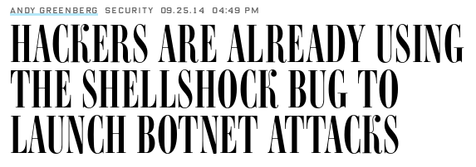
Notes:
The thing I want to draw attention to here is the date - 24 hours after disclosure, not only is a botnet up and alive in the wild exploiting this, Wired have already put an article out to print on it!
.
The botnet was called Wopbot
.
Demo – reverse shell on Vulnhub’s CVE-2014-6271 Shellshock iso

Slide 6
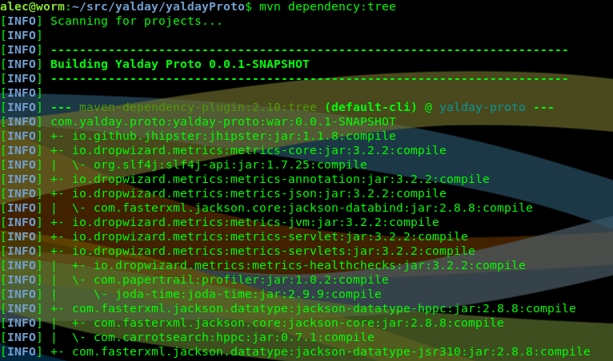
Notes:
That’s a system-level example, what does this mean for devs?
.
Could write everything ourselves
.
Libraries sensible and inevitable
.
Easily over 100.
.
I don’t have a clue what or what versions EPDI use.

Slide 7
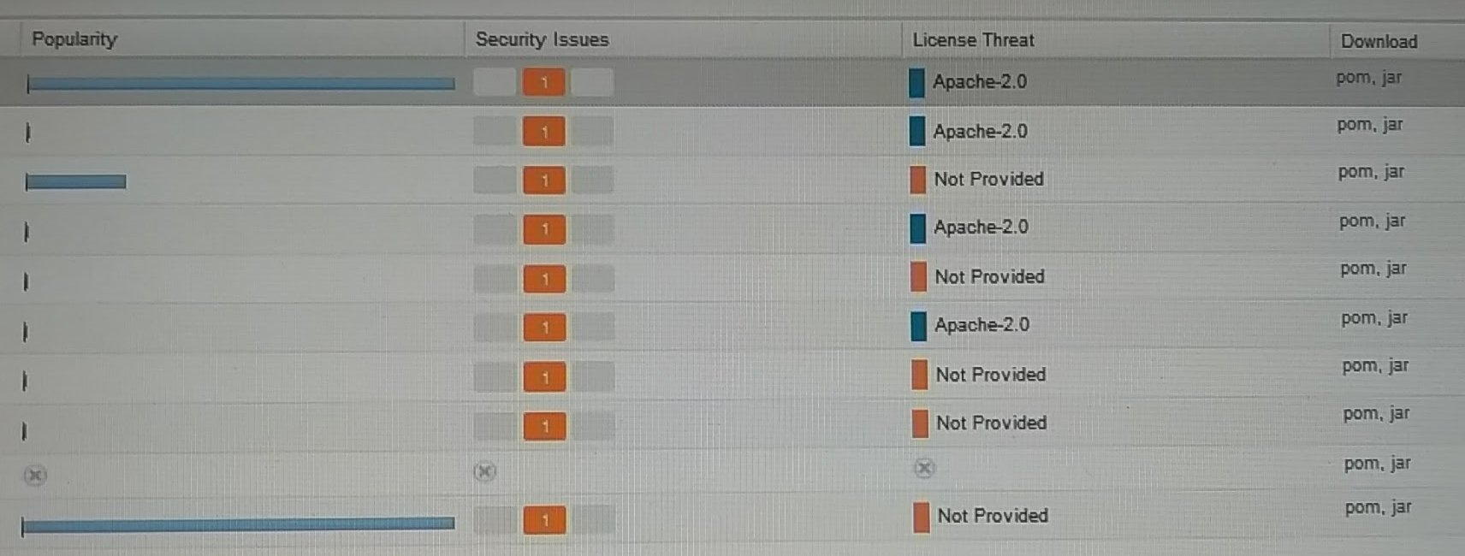
Notes:
What can we do in here?
.
FRS

Slide 8

go/oss
Notes:
Vendor product
.
Bought in to the firm
.
Tollgate for prod
.
Maintains a database of vulnerabilities within oss libs

Slide 9
Best Practices
BlackDuck can be done as part of your CI
Keep scanning while in prod
Release often
Keep up with API changes
Continually adjust your threat model
Keep libraries loosely coupled
Notes:
Talk from slide
.
Don’t have to update and release every time a vulnerability is found

Slide 10
Pitfalls
OSS ‘Many eyes’ – Just because you can, doesn’t mean they did
Proxy out of the bank for NPM repos
BlackDuck only knows about disclosed vulns
Notes:
BASH bug existed since 1989

Slide 11
Any Questions?

